Slide 1
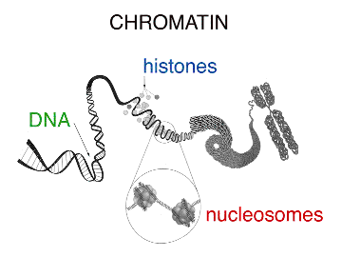
Chapter Nine: Mitosis Notes pt. 1
The Cellular Basis of Inheritance

Slide 2
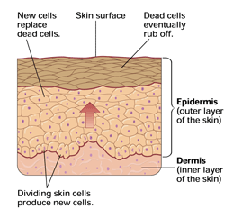
What Happens When A Cell Dies?
It has to be replaced by a cell of its OWN TYPE! (all cells come from pre-existing cells)
Cells do not grow – they replicate
3 reasons Cells Undergo Mitosis:
Growth
Injury – Repair
Reproduction (asexual)

Slide 3
What We Know
Chromosomes contain all of our DNA
Our DNA is coiled up extremely tight and wrapped around proteins (called histones) so that it is able to fit into the cell
Each one of our cells contains over 3 billion Nitrogen bases (GCAT)
DNA can replicate itself
DNA encodes for proteins

Slide 4
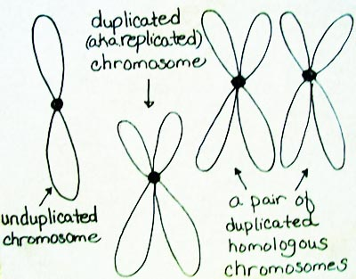
Chromosomes
Arranged into 23 pairs (46 chromosomes total)
Pairs of Chromosomes are similar in:
Size
Shape
We call pairs of chromosomes homologous chromosomes

Slide 5
Karyotypes
Diagram that shows all 23 of our chromosome pairs arranged by size
First 22 pairs of chromosomes are called autosomes
Autosomes determine everything about you except sex
Last pair of chromosomes, the 23rd pair, are sex chromosomes
Sex chromosomes determine your sex
OR
23rd Pair
Autosomes
Sex Chromosomes

Slide 6
Cellular Reproduction
Asexual (Mitosis): process in which a single cell or set of cells produces offspring that inherit all their genetic material from one parent
Reproduction of body cells (Somatic cells)
Sexual (Meiosis): process in which genetic material from two parents combines and produces offspring that differ genetically from either parent
Reproduction of sex cells (gametes)

Slide 7
Chromatin
DNA is located in the nucleus
In the nucleus, DNA is found on long, thin fibers called Chromatin
Chromatin consists of DNA wound around proteins called histones
Next the DNA is wrapped into a tight helical formation
Chromatin condenses into chromosomes

Slide 8
Chromatin vs. Chromosomes
Chromatin
Chromosomes
Unwound DNA
Found throughout Interphase
DNA is being used for protein synthesis
Tightly packaged DNA
Found only during Cell Division
DNA is not being used for protein synthesis

Slide 9
Structure of Chromatin

Slide 10
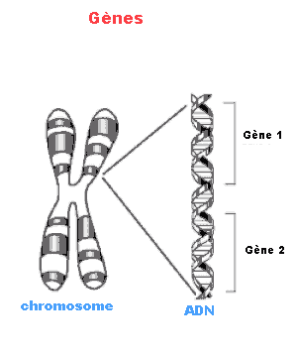
Chromosomes
When a cell is preparing to divide, chromatin condense into chromosomes
The human somatic cell (body cell) has 46 chromosomes = diploid (2n)
The human gamete (sex cell - an egg and sperm cell) only has 23 chromosomes = haploid (n)
Each chromosome may contain thousands of genes

Slide 11
Chromosome Structure
Chromosome – Structure containing all of our DNA
Chromatids – Individual half of a duplicated chromosome
During cell division our chromosomes divide into sister chromatids
Centromere – point in the middle where chromosomes are joined.

Slide 12
Chromosomes
Before a cell divides, it replicates all of its chromosomes
Each chromosome now consists of 2 identical joined copies called sister chromatids
Each sister chromatid is joined by a centromere

Slide 13
Chromosome Structure

Slide 14
Chromosome

Slide 15
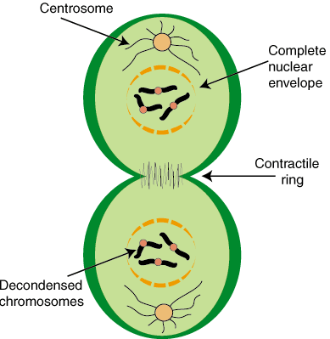
Chromosome Action During Cell Division
During cell division:
DNA is doubled
Chromosomes divide sister chromatids
One chromatid goes to the original cell and the other chromatid goes to the copy cell

Slide 16
Chapter Nine: Mitosis Notes pt. 2
The Cellular Basis of Inheritance

Slide 17
Cell Cycle and Mitosis
The eukaryotic cell cycle is divided into two major phases:
Interphase
Cell Division

Slide 18
Before We Divide…
Cell Parts that play a role in cell division
Chromosomes: “X” shaped structures that hold DNA (you have 46 chromosomes in all of your body cells!)
Chromatin: Chromosomes in the form of “spaghetti” (wound up tightly)
Sister Chromatids: One pair of chromosomes (looks like a “>”)

Slide 19
Before We Divide
More Cell Parts!
Spindle Fibers: holds the chromosomes in place in the cell (looks like strings across the cell)
Centrioles: Hold the spindles in place (looks like rectangle blocks)
Centromere: Hold sister chromatids together

Slide 20
Cell Cycle Stages
Interphase
Preparation Stage
Prophase
Metaphase
Anaphase
Telophase
Cytokinesis
Cytoplasmic Division
Mitosis(PMAT) = Nuclear Division

Slide 21
Interphase
90% or more of the cell cycle is spent in interphase
What happens here??
Cellular organelles double in number
DNA replicates
Protein synthesis occurs
Chromosomes NOT visible
DNA appears as uncoiled chromatin

Slide 22
Interphase
Divided into 3 stages:
G1
S
G2

Slide 23
Interphase: G1
Cell grows and differentiates
Organelles are made
Chromosomes have NOT replicated

Slide 24
Interphase: S
DNA Synthesis occurs
Chromosomes replicate (46 chromosomes to 92 chromosomes) in preparation for cell division
Each chromosome now consists of two chromatids attached at the centromere

Slide 25
Interphase: G2
Molecules that are required for cell replication are synthesized (made)

Slide 26
Interphase
Plant Cell Interphase
Animal Cell Interphase

Slide 27
Cell Division
Consists of:
Nuclear Division
Cytoplasmic division
Nuclear division – Mitosis
Cytoplasmic Division - Cytokinesis

Slide 28
Mitosis
Process that ensures each daughter cell receives the same number of chromosomes as the original parent cell
Divided into:
Prophase
Metaphase
Anaphase
Telophase

Slide 29
Prophase
Chromatin condenses
Chromosomes become visible (92 Chromosomes)
Nucleolus disappears
Nuclear membrane begins to fragment
Spindle fibers form & attach to centromeres of chromosomes

Slide 30
Prophase
Prophase in Plant Cell
Prophase in Animal Cell

Slide 31
Metaphase
Nuclear Membrane has fully disappeared
Duplicated chromosomes (92 of them) line up along the cells equator
Metaphase in a plant cell
Metaphase in an animal cell

Slide 32
Anaphase
Diploid sets of daughter chromosomes:
Separate
Pushed toward opposite poles of the cell – end of the cells (46 on each end)

Slide 33
Anaphase
Anaphase in a plant cell
Anaphase in an animal cell

Slide 34
Telophase
Nuclear Membrane and nucleoli reform (46 chromosomes in each new nucleus)
Cells start to separate into 2 cells
Cytokinesis is nearly complete (Cytokinesis occurs during telophase)
Chromosomes uncoil to chromatin

Slide 35
Telophase
Telophase in a plant cell
Telophase in an animal cell

Slide 36
Cytokinesis (Cytoplasmic Division)
Dividing cell separates into 2 diploid daughter cells
Each are exactly like the original – 46 chromosomes in each

Slide 37
Cytokinesis Plant vs. Animal
Cytokinesis in Plant Cells
Cytokinesis in Animal Cells
Plant cells have a cell wall and the cytoplasmic membrane
The cell forms a cell plate that separates the cytoplasm into two daughter cells.
Animal cells lack a cell wall and are surrounded by a cytoplasmic membrane
Microfilaments of actin and myosin attached to the membrane form constricting rings around the dividing cells and separate the cytoplasm into 2 daughter cells.

Slide 38
Cytokinesis: Plant vs. Animal

Slide 39
At the end of Mitosis
2 Diploid cells are produced
Somatic Body cells
Genetically identical cells produced
46
Duplicate!
92
92
Divide!
46
46

Slide 40
Chapter Nine: Mitosis Notes pt. 3
The Cellular Basis of Inheritance

Slide 41
What Happens When Mitosis Goes Wrong??
Cancer
Caused by uncontrolled cell reproduction (mitosis) and severe disruption of the mechanisms that control mitosis

Slide 42
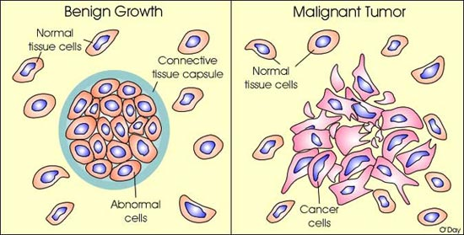
Tumors
The uncontrolled cells form a mass called a tumor
Two types of tumors
Benign
Malignant

Slide 43
Tumor Types
Benign Tumor
Malignant Tumor:
Abnormal mass of normal cells
Abnormal mass of cancer cells
Malignant tumor displaces the normal tissue as it grows
If it is not removed, the cells can break off and spread to other areas of the body via blood or lymph
The spread of cancer cells beyond their original site is called metastasis

