Slide 1
Macromolecule 3: Lipids
Lipids are commonly fats & oils.
• Lipids are NON-POLAR.
• They have a VERY high carbon & hydrogen
concentration and very little oxygen. Beef Fat = C₅₇H₁₁₀O₆
• In the body, they are held together by HIGH
ENERGY BONDS. This is because they store heat & energy and are a major component of the cell membrane.

Slide 2
LIPIDS
AT THE ATOM LEVEL
Lets rewind real quick…each carbohydrate is made up of…
Carbon, Hydrogen, and Oxygen
THINK: “CHO”

Slide 3
Lipids like Carbs?
You might have noticed that both carbohydrates and lipids have the elements Carbon, Hydrogen, and Oxygen.
“CHO”
A carbohydrate, has twice as many hydrogen atoms as the number of oxygen atoms.
EX: C₆H₁₂O₆
(This is a carb= there are double the number of H compared to O)
On the other hand, lipids have a lot more than twice the amount hydrogen atoms as the number of oxygen atoms.
EX: C₂₇H₄₆O cholesterol

Slide 4
What is your Function?
Function for Lipids is that of Energy storage.
Lipids contain a lot of calories in a small space.
Since Lipids are generally insoluble in polar substances such as water, they are stored in special ways in your body's cells.
Lipids can also function as structural components in the cell.
Phospholipids are the major building blocks of cell membranes.
They INSULATE the body to maintain normal body temperature and they CUSHION the internal organs for protection.
They produce hormones for the body called STERIODS

Slide 5
Building blocks
Lipids are chains (polymers) made of monomers.
Lipids are made of glycerol and fatty acids
The lipid building blocks: The common building block for most of the different types of lipids is the fatty acid. Fatty acids are composed of a chain of methylene groups with a Carboxyl functional group at one end.

Slide 6
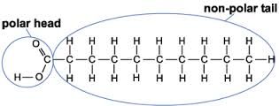
Building Blocks
The methyl chain is the fatty part, the Carboxyl, the acid. The fatty acid chains are usually between 10 and 20 Carbon atoms long.
The fatty "tail" (methyl chain) is non-polar (Hydrophobic) while the Carboxyl "head" is a little polar (Hydrophillic).

Slide 7
Glycerol Head
Fatty Acid Tail

Slide 8
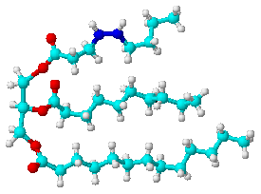
The Shape of a triglyceride is like the letter
E
This is a triglyceride molecule

Slide 9
Saturated or Unsaturated?
Fatty acids can be saturated (meaning they have as many hydrogen bonded to their carbons as possible) or
Unsaturated (with one or more double bonds connecting their carbons, hence fewer hydrogen).

Slide 10
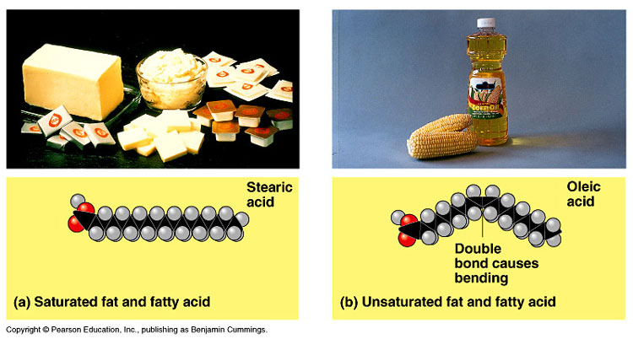
Saturated vs. Unsaturated Fat

Slide 11
Saturated vs. Unsaturated Fat
Single Bond Carbon Chain
“Saturated” w/ H atoms
Straight tail
Solid at room temperature
Double Bond Carbon Chain
“Unsaturated” w/ H atoms
“Kinked” tail
Liquids at room temperature

Slide 12
LIPIDS
WHERE ARE THEY FOUND?
In plants
In animals- in adipose tissue, connective tissue, in animals
Lipids make up the cell membrane of all cells.

Slide 13
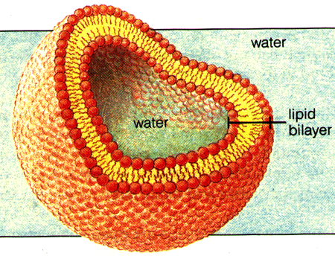
Phospholipids
Important lipid that makes up the Phospholipid Bilayer of a cell membrane

Slide 14
Polar Phosphate-
Glycerol Head
Hydrophilic
2 Nonpolar
Fatty Acid Tails
Hydrophobic

Slide 15
Phospholipid Bilayer
Outside Cell (watery)
Inside Cell (watery)

Slide 16
Phospholipid Bilayer

Slide 17
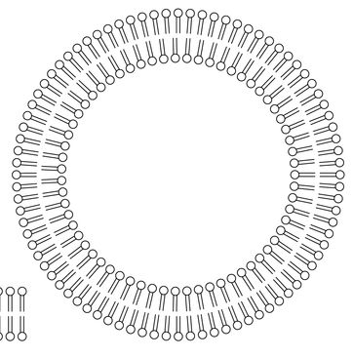
Phospholipid Bilayer
H₂O
Polar
Environment
H₂O
Polar
Environment

Slide 18
Steroids
Steroids (cholesterol and hormones) are lipids
Notes:
Anabolic Steroids = Building Steroids, initiates protein production, tissue production
Side Effects: Decreased Sperm production & Acne, increased cholesterol

Slide 19
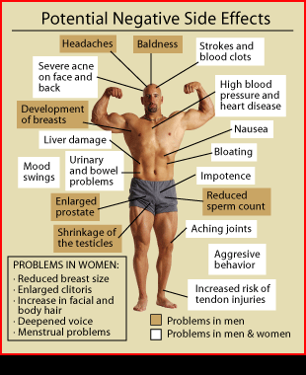
Notes:
Anabolic Steroids = Building Steroids, initiates protein production, tissue production
Side Effects: Decreased Sperm production & Acne, increased cholesterol

