Slide 1
Earth Shakes, Rattles, and Rolls
Earth and Environmental Science

Slide 2
What is the relationship between the earth’s plates and earthquakes?

Slide 3
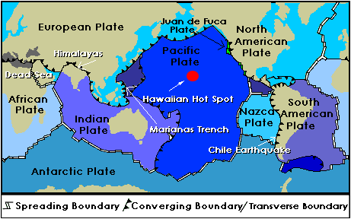

Slide 4
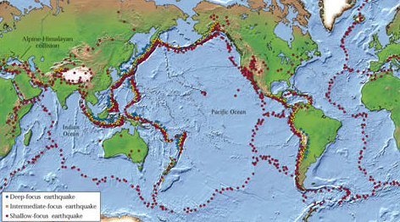

Slide 5
Earthquake Vocabulary
Focus: The point beneath the Earth’s surface where rocks break and move. (Earthquake’s point of origin)
Epicenter: The point ON the Earth’s surface, directly above the focus.
Magnitude: measure of energy released during earthquake
Seismic Wave: waves produced by earthquakes
Liquefaction: When water-saturated sediment temporarily loses strength and acts as a liquid. Caused by seismic waves.
Seismograph: record seismic waves

Slide 6
Earthquake Important Facts
Earthquakes (and volcanoes) are found where plates meet.
Shaking of earth due to movement of rocks along a fault.
Rocks under stress accumulate strain energy over time. (Form of potential energy)
When stress exceeds strength of rocks, rock breaks.
Strain energy is released as seismic waves.

Slide 7
Earthquake Waves
Types of seismic waves:
Body waves-travel through interior
Surface waves-travel on surface of earth
Specific Body Waves:
Primary waves or P-waves: highest velocity, causes compression and expansion in direction of wave travel.
Secondary waves or S-waves: Slower than P-waves but faster than surface waves; causes shearing of rock perpendicular to direction of wave travel; CAN NOT travel through liquids

Slide 8
Earthquake Waves
Surface Waves:
Love Waves: moves surface ground side to side; fastest surface wave
Rayleigh Waves: rolls on the surface just like a wave rolls across the ocean.

Slide 9
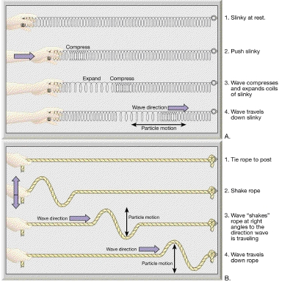
Primary or “P” Wave
Secondary or “S” Wave

Slide 10
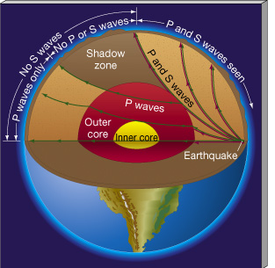

Slide 11
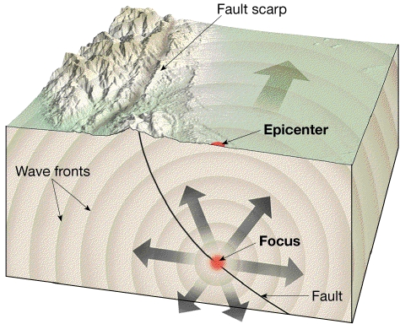

Slide 12
Time-Travel Curve

Slide 13
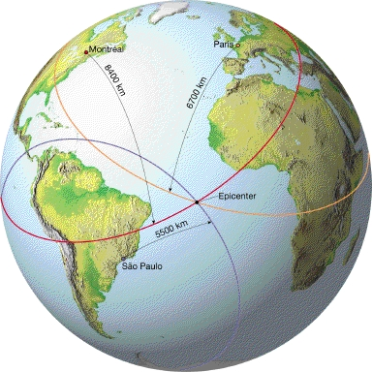
Triangulation of 3 stations to locate earthquake epicenter

Slide 14
Determining the magnitude of an earthquake
Richter Magnitude:
Measure amplitude of largest S wave on seismograph record(seismogram)
Take into account distance between seismograph and epicenter
Richter Scale:
Logarithmic numerical (NOT a physical) scale
Increasing one whole unit on Richter Scale represents 10 times greater magnitude.
Intensity:
Intensity refers to the amount of damage done in an earthquake
Mercalli Scale is used to express damage

Slide 15
Earthquake Prediction
How can scientists predict an earthquake?
Currently….they can’t
Future technology will monitor subsurface seismic waves and periodic shifting indicative of future “slippage”
Tracking organic movement is also a source of future study

Slide 16
Earthquake Hazard Potential Map

Slide 17
3 Types of Faults
Normal
Reverse
Strike-Slip

Slide 18
Normal Fault
The hanging wall moves down relative to the foot wall.
This fault type is caused by tensional stress.

Slide 19
Normal Fault

Slide 20
Reverse Fault
The hanging wall moves up relative to the foot wall.
This fault is caused by Compressional stress.

Slide 21
Reverse Fault

Slide 22
Strike-Slip Fault
The fault exists
between two pieces
of crust and the
Movement occurs
horizontally where
the sides slide past
each other.
This fault type is caused by shear stress.

Slide 23
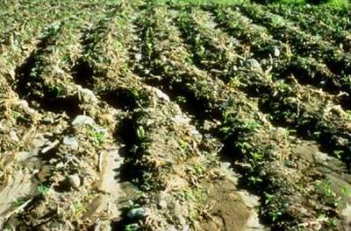
Strike-Slip Fault

